Slide 1
Blockchain
A Walk Through Digital Blocks
2018

Slide 2
root@kali:~#whoami
12 year security professional
8 years with Protiviti
@michaellyons201
CISSP, CISM, QSA, GCED, GSEC
Proficiencies
Network Design
Vulnerability Management
PCI Compliance
System Hardening
SOC/SIEM Implementation
100lb dog named Houdini
Former Ski Instructor
National Parks Annual Pass Holder
R2D2 Builder

Slide 3
C:\> whoami /all
12 year security professional
7 years with Protiviti
@robertwnoblit
CISSP, QSA
Proficiencies
PCI Compliance
HIPAA Compliance
Network Design
Vulnerability Management
System Hardening
100lb dog named ‘Pior Von Diesel Maximus’
United States Marine

Slide 4
What is blockchain technology

Slide 5
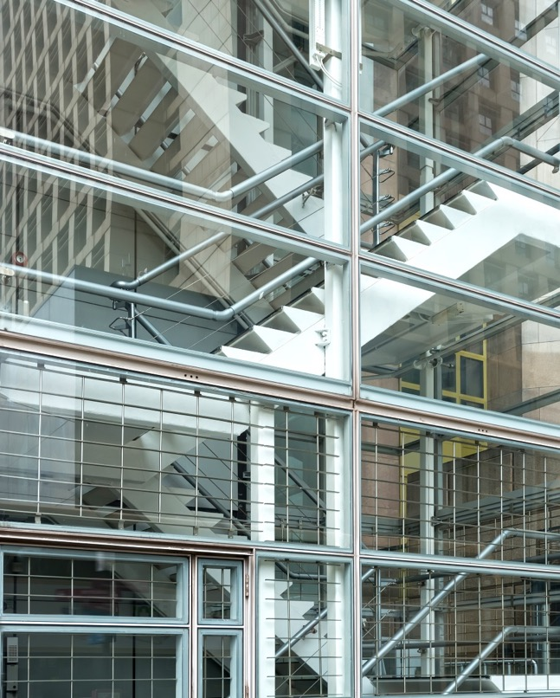
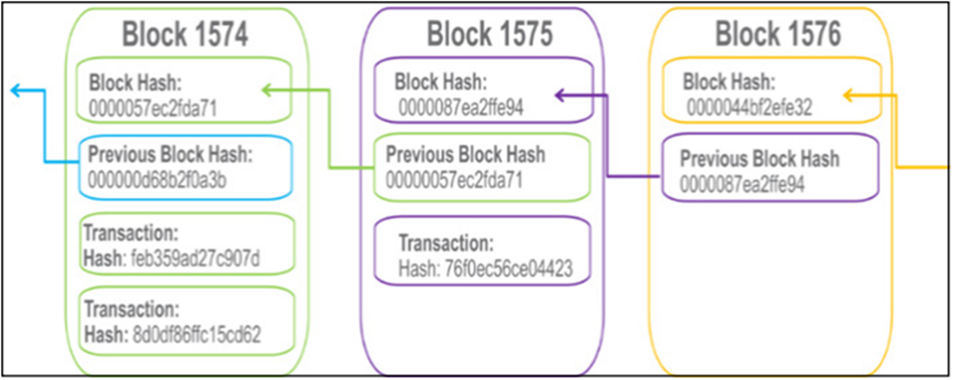
What is Blockchain and its Underlying Architecture?
Blockchain is an algorithm and a distributed data structure for managing Information without a central administrator and amongst people who know nothing about one another. Originally designed for the crypto-currency Bitcoin, the blockchain architecture was driven by a rejection of money and bank-controlled payments but has evolved into much more

Slide 6
Components BlockChain Ecosystem
There are four main items needed to create a blockchain.
A Node Application
Each computer willing to participate must have the application specific to the blockchain ecosystem
A Shared Ledger
The data structure inside the application, each member can see the shared ledger
A Consensus Alogrithm
Rules of the Game
A Virtual Machine
Computer Inside a Computer

Slide 7
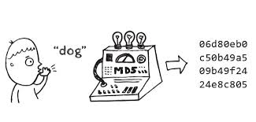
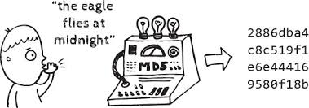
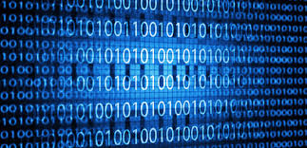
Components of BlockChain Information
There are three main pieces of information that each block contains.
A cryptographic hash for the block
The cryptographic hash for the previous block
The timestamped data stored on the block

Slide 8
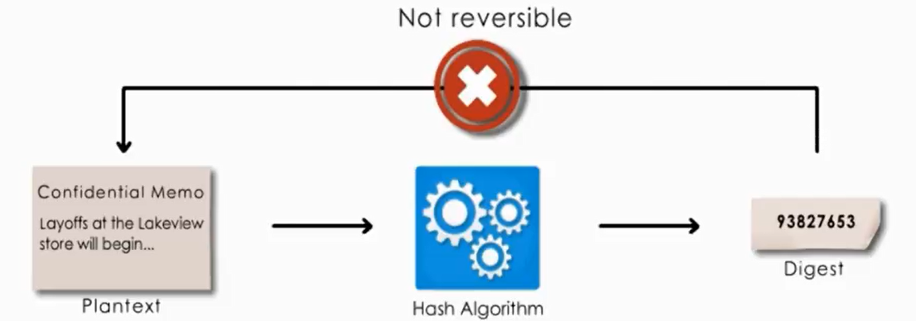
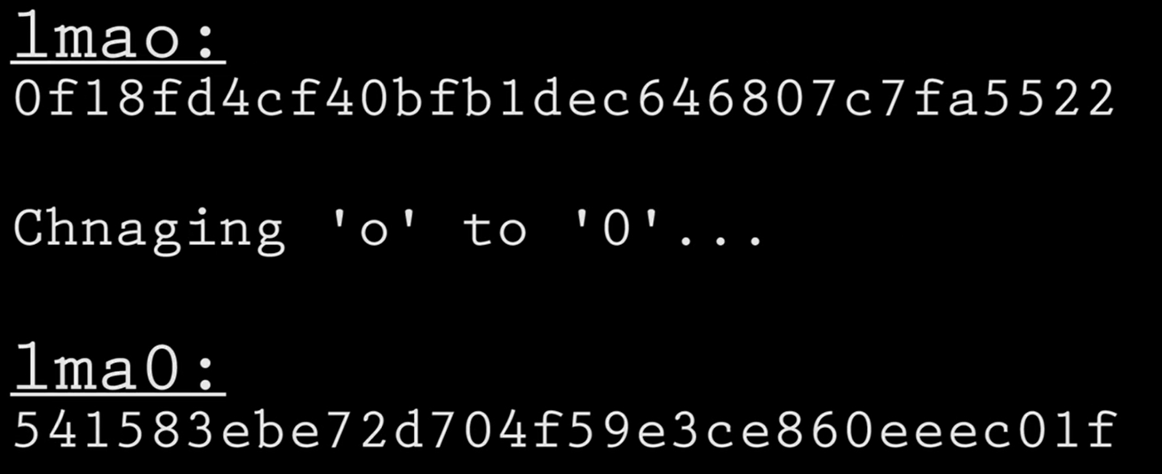
What is a Hash?
Hashing is a one way mathematical function for generating a unique fixed length value to represent input data.

Slide 9
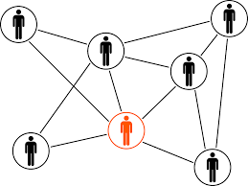
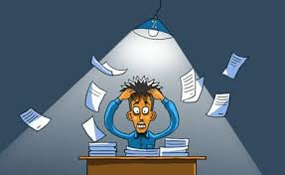
How does a block form
Person creates the information for the blockchain and then creates hash
Person pushes the information out to the blockchain client (you can write your own or leverage an existing blockchain) and is distributed to all members of that group
Proof of Work function occurs (approximately ten minutes) and is a validation of the block and allows for transactions to be posted (and this is bitmining)

Slide 10
How does it work
HASH: 1RTY
HASH: 4FEE
HASH: KJL7
HASH: GX32
PRV HASH: 0000
PRV HASH: 1RTY
PRV HASH: 4FEE

Slide 11
Key Characteristics of A Blockchain Network
Consensus
For a transaction to be valid, all participants must agree on its validity.
Immutability
No participant can tamper with a transaction after it’s been recorded to the ledger. If a transaction is in error, a new transaction must be used to reverse the error, and both transactions are then visible.
Provenance
Participants know where the asset came from and how its ownership has changed over time.
Finality
A single, shared ledger provides one place to go to determine the ownership of an asset or the completion of a transaction.

Slide 12
How is blockchain being used

Slide 13
Usage of Blockchain Industry Wise
Among companies deploying or considering deploying blockchain, here’s the breakdown of what they plan to use it for. Settlements/payments clearly dominate early deployments.

Slide 14
Usages of Bitcoin
1
Banking & International Payments
In Blockchain technology, all the data is shared and its entries are encrypted and confirmed it also provides an easy way to create a safe and secure log of all the sensitive activities whatsoever. This feature of the Blockchain technology can be used for money transfers and international payments.
Large commercial bank has many retail clients who always compete to get efficient and cheaper payments, especially in the case of international transfers. This need of the clients can be settled by using the blockchain technology, as its application will reduce the requirement of manual settlement of the transactions by the bank.
2
Audit and Regulatory Compliance
Due to the extremely secure nature of the Blockchain, it is found useful for audit and accounting. As all the data in the Blockchain technology is secure, encrypted and confirmed, it keeps the integrity of the records and reduces any possibility of error.
The special benefit of using this technology in the accounting field is that once the account records are created and are locked with blockchain technology, no one is authorized to change the records, not even the owner of the records. This could potentially eliminate any need of the auditors.

Slide 15
Continued Uses for Bitcoin
3
Energy Markets
LO3 Energy has developed a technology for trading of solar energy locally using a peer-to-peer blockchain solution. The first real application with 50 physical units has been tested in Brooklyn, in cooperation with Siemens. The project “Brooklyn microgrids” applies smart meters for tracking energy generation and consumption combined with smart contracts for energy transactions between actors on the grid. One key question raised is the scalability of the project. Specifically, the computing power that is needed for validating the microgrid transactions and that is increasing with the grid size is considered as one of the key challenges for scaling the project.
Other companies trying similar concepts are Wien Energy, that is focusing on energy trading between utilities, and Innogy, conducting tests with blockchain to automate the billing process of charging stations for electrical vehicles.
Further development in the energy sector has been made by the startup Electron, that is creating technology that enables customers to faster switch their electricity suppliers.
4
SMART PROPERTY
The registration and transfer of property rights — land or other valuable assets like cars — can be realized through blockchain in a secure and efficient way. A first application has been tested in Sweden, with actors such as the Swedish National Land Survey Lantmäteriet, telecommunication company Telia, banks Landshypoteket and SBAB, and startup ChromaWay. Intangible assets can be transferred over blockchain; for instance, intellectual property rights, wills, art and other documents, which could be stored in the immutable blockchain.
Current actors developing solutions for this are Binded, Pixsy, TinEye and Ascribe.

Slide 16
Risks associated with blockchain

Slide 17
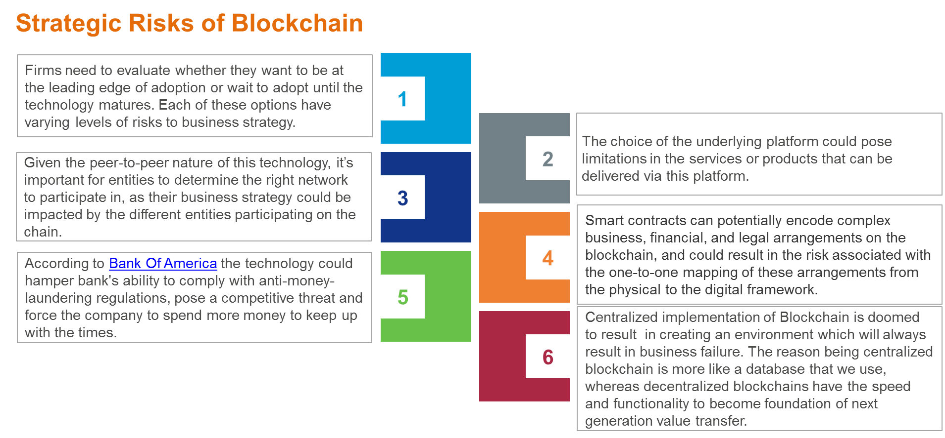

Slide 18
General Risks Associated with Blockchain
Scalability and Transaction Fees
The time is taken to put a transaction in the block.
The time is taken to reach a consensus.
Data privacy
Transaction transparency on the blockchain not easily compatible with the privacy needs in banking.
Decentralized Autonomous Organization
Who is responsible if laws are broken?
What, if, any, is the liability of DAOs and their creators?
Who or what is claimed against in the case of a legal dispute?
Jurisdiction
Complex jurisdictional issues as nodes are located anywhere in the world and require careful consideration in relation to the relevant contractual relationships.
Encryption
Anyone with the encryption key can read the encrypted data if the key is made public, while if the key to unlock the blockchain is lost you can never get it back.
SLA and Performance
No guarantee for availability and performance from vendors offering “blockchain-as-a-service”

Slide 19
Next steps for Auditors

Slide 20
Is Internal Audit Ready for Blockchain?
Blockchain technology offers the promise of a safe, transparent, rapid and affordable digital solution to many industry challenges.
However, this same technology also poses challenges and opportunities to internal auditors wishing to provide maximum value to their organizations.
In order to rise to the challenges and capitalize on the opportunities, internal audit departments must be able to place auditors – well trained on both blockchain technology and on all blockchain projects right from their inception.

Slide 21
Blockchain: A Game Changer for Audit Processes
Adapt to the New Environment
Internal auditors need to update themselves as the information will be in new formats.
Internal auditors will need to understand that some work being routinely performed today will become redundant.
For example, with a shared ledger there will no longer be any requirement to reconcile differences between systems of record. Instead, there will be one version of the truth and all stakeholders will have access to it.
There will be a new technical environment where critical information is created and stored and internal auditors must be able to access information contained in this environment.
Updated Knowledge and Skills
Internal auditors must possess the knowledge, skills, and other competencies needed to perform their individual duties.
Before adopting blockchain, training people on blockchain is a necessity.
In order to effectively deal with blockchain-based applications, the focus must be on understanding the basics of the technology and, in particular, the evolving area of governance.
Early Involvement
Internal auditors need to get involved at the planning stage of blockchain-based applications.
All systems must have adequate governance, risk management, and controls, and it is much easier to build these in right from the start than to retrofit them after a problem has been identified.

Slide 22
Way Forward for Auditors
Blockchain certainly has the potential to enable numerous new digital solutions to many of the challenges large organizations face.
Auditors must, however, take the necessary steps today to ensure that the blockchains of tomorrow are subject to the same high standards as all other business systems and processes. Otherwise, we risk that potential being unrealized.

